Slide 1

Plant Disease Detection using Deep Learning Presented by: GANDHIMATHI B III year ,AI & DS COLLEGE-KVCET NM ID-au421221243006 Email ID- gandhimathibalu25@gmail.com

Slide 2
Introduction
Importance of plants in climate change, agriculture, and economy: Plants play a crucial role in mitigating climate change, sustaining agriculture, and driving economic growth
Impact of plant diseases on food production and industry losses: Plant diseases can severely impact food production and lead to significant losses in various industries
Need for timely disease detection and prevention: Timely detection and prevention of plant diseases are essential to ensure food security and economic stability

Slide 3

Objective
Develop a deep learning based model to detect plant diseases from leaf images: The aim is to leverage deep learning techniques to accurately identify and diagnose plant diseases using image data
Utilize Convolutional Neural Networks for feature extraction and classification: CNNs are well suited for image analysis tasks due to their ability to capture spatial hierarchies of features

Slide 4
Methodology
Data Preprocessing: Employing techniques such as image augmentation and resizing to enhance the robustness of the model
Model Architecture: Designing a CNN architecture with multiple convolutional and pooling layers to extract relevant features from leaf images
Slide 5: Model Architecture Visual representation of the CNN model architecture showcasing the arrangement of convolutional, pooling, and fully connected layers

Slide 5
Training Process
Dataset Splitting: Dividing the dataset into 80% for training and 20% for testing to assess the model's generalization performance
Hyperparameters: Tuning parameters such as epochs, batch size, and learning rate to optimize model training
Optimization Technique: Employing gradient descent as the optimization technique to minimize the loss function during training

Slide 6
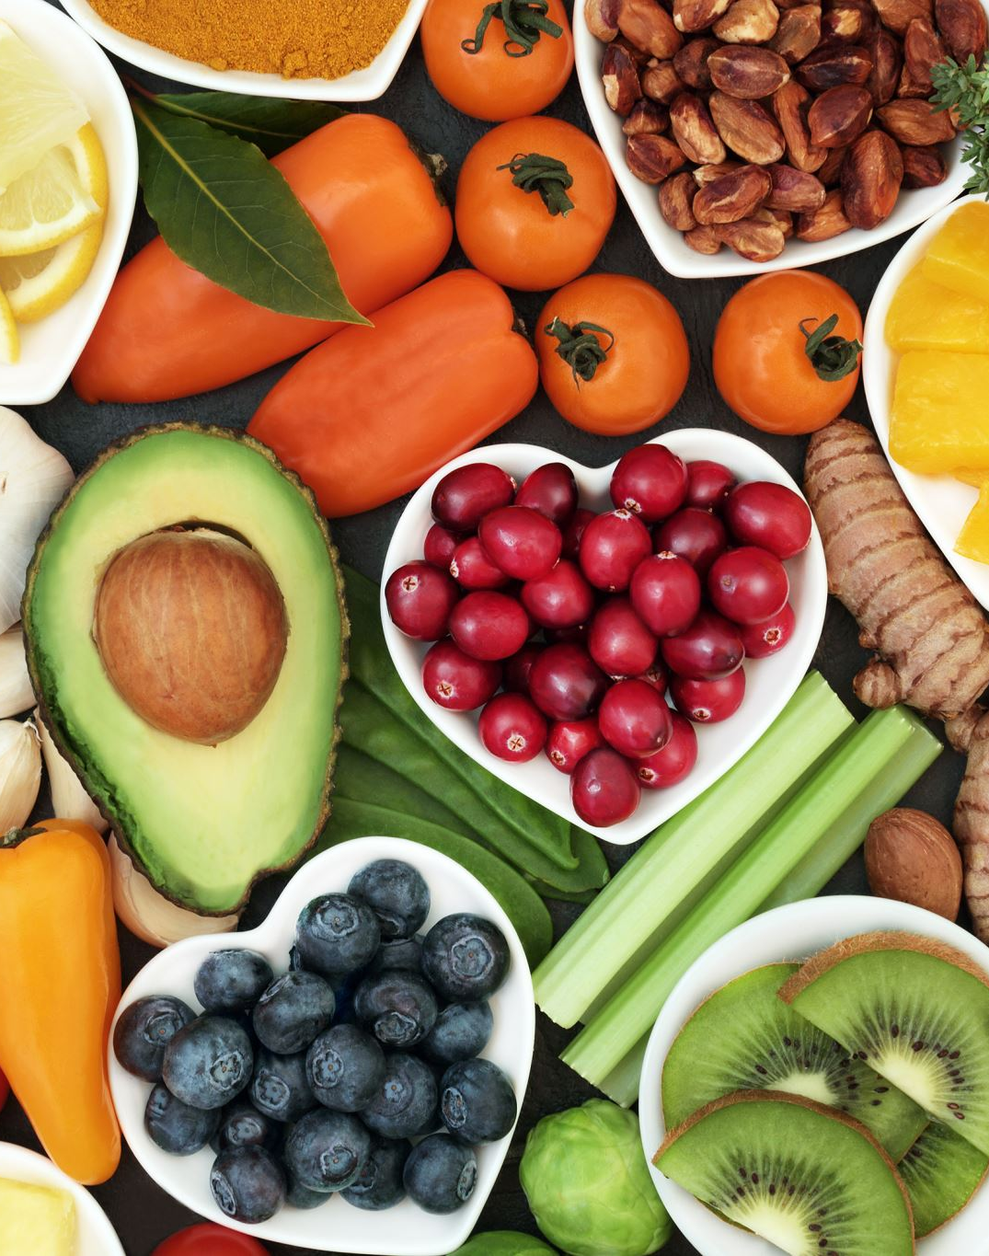
Performance Analysis
Classes with High Accuracy: Identifying classes with high accuracy, such as Corn and Tomato
Classes with Lower Accuracy: Discussing classes with lower accuracy, like Apple and Cherry, and analyzing potential reasons for misclassifications

Slide 7
Real-world Testing
Testing on Locally Captured Images: Assessing the model's performance on images captured in real-world settings
Slide 10: Conclusion Summarize the Study's Findings: Summarizing the key findings of the study, emphasizing the effectiveness of deep learning for plant disease detection
Highlight the Effectiveness of Deep Learning: Emphasizing the potential of deep learning techniques in revolutionizing agricultural practices through efficient disease detection

Slide 8
Future Work
Integration with Drones or Robotics: Exploring integration with drones or robotics for live detection of plant diseases in agricultural fields
Expanding the Dataset: Continuing to expand the dataset to encompass more plant types and diseases for improved model generalization
Exploring Advanced Neural Network Architectures: Investigating advanced neural network architectures to further enhance the accuracy and robustness of the model

